Slide 1


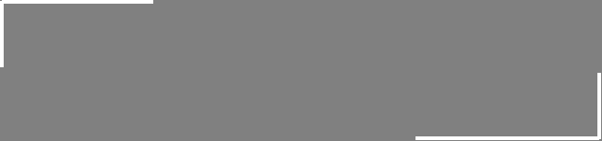
Linear Algebra
in
Neural Networks
YOUR NEXT DESTINATION
OF SOFTWARE OUTSOURCING

Slide 2
Overview
Artificial Neuron
Artificial Neural Network
Weight Matrices
Forward Pass
Activations

Slide 3
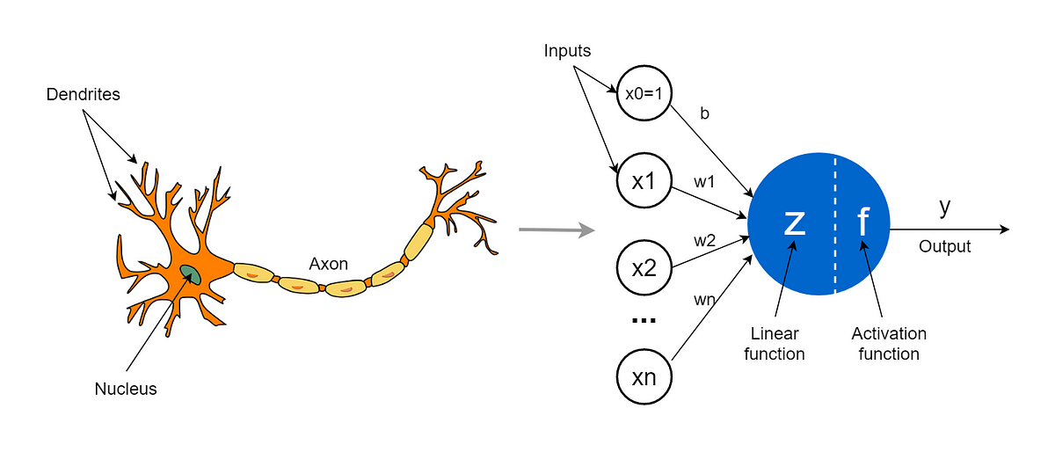
Artificial Neuron (1 / 3)

Slide 4
Artificial Neuron (2 / 3)
Z = w1.x1 + w2.x2 + w2.x2 + … + wn.xn + b
y = f(Z)

Slide 5
Artificial Neuron (3 / 3)
x1
x2
x3
.
.
.
xn
w1
w2
w3
.
.
.
wn
X =
W =
(n x 1)
(n x 1)
Z = W^{T} * X + b
Z = w1.x1 + w2.x2 + w3.x3 + … + wn.xn + b

Slide 6
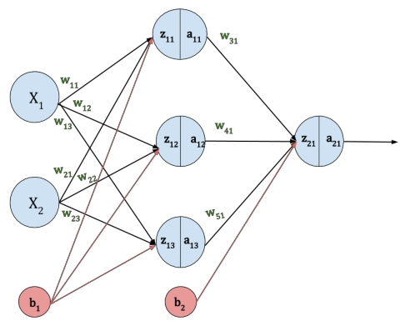
ANN

Slide 7
Weight Matrices (1 / 2)
X₁
X₂
X =
W₁₁, W₁₂, W₁₃
W₂₁, W₂₂, W₂₃
W₁ =
W₃₁
W₄₁
W₅₁
W₂ =

Slide 8
Weight Matrices (2 / 2)
X₁
X₂
X =
W₁₁, W₂₁
W₁₂, W₂₂
W₁₃, W₂₃
W₁^{T} =
W₂^{T} =
W₃₁, W₄₁, W₅₁

Slide 9
Forward Pass (1 / 3)
Z₁ = W₁^{T} . X + b₁
W₁₁, W₂₁
W₁₂, W₂₂
W₁₃, W₂₃
X₁
X₂
Z₁ =
.
+ b₁
W₁₁ . X₁ + W₂₁ . X₂ + b₁
W₁₂ . X₁ + W₂₂ . X₂ + b₁
W₁₃ . X₁ + W₂₃ . X₂ + b₁
Z₁₁
Z₁₂
Z₁₃
=
=

Slide 10
Forward Pass (2 / 3)
Z₁ = W₁^{T} . X + b
f(Z₁₁)
f(Z₁₂)
f(Z₁₃)
A₁ = f(Z₁ ) =
a₁₁
a₁₂
a₁₃
=

Slide 11
Forward Pass (3 / 3)
Z₂ = W₂^{T} . A₁ + b₂
a₁₁
a₁₂
a₁₃
Z₂ =
W₃₁, W₄₁, W₅₁
.
+ b₂
=
W₃₁ . a₁₁ + W₄₁ . a₁₂ + W₅₁ . a₁₃ + b₂
A₂ = f(Z₂ ) =
a₂₁

Slide 12
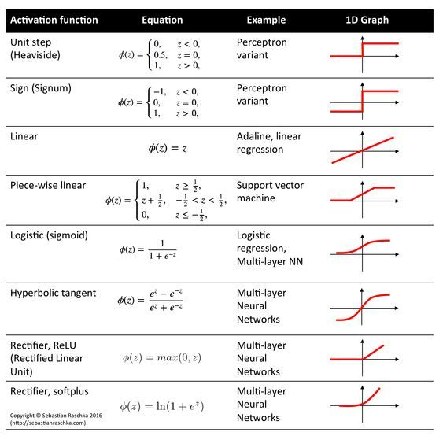
Activations

Slide 13
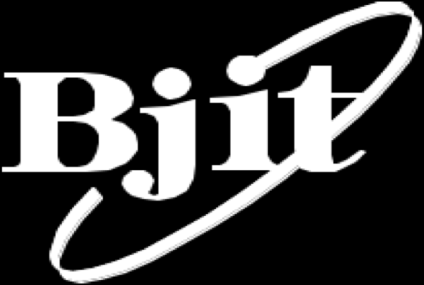
Thank You
Get in touch with us:
www.bjitgroup.com

